Slide 1




SQL Server Databaseology A Deep Dive Into Database Internals
John Morehouse
Consultant
Denny Cherry & Associates Consulting
john@dcac.co
http://linkedin.com/in/sqlrus
@SqlRUs
http://www.sqlrus.com

Slide 2


Who Am I?
Leader of the Louisville SQL Server/Power BI User Group
Organizer/Speaker of SQL Saturday’s & other conferences
Heavily involved with SQL PASS
Microsoft Data Platform MVP
Friend of Redgate 2015 - 2018
Idera ACE 2016
SentryOne Product Advisory Council

Slide 3
Where Am I?
The vetted and certified experts at Denny Cherry and Associates Consulting assist companies with attaining IT goals such as HA, scalability, SQL Server virtualization, migration, and acceleration reliably while finding ways to save on costs. With clients ranging from Fortune 50 corporations to small businesses, their commitment to each is the same: to provide a deft, high-speed IT environment that leverages every aspect of their platform: from architecture, infrastructure, to network.
Visit DCAC at http://www.dcac.co

Slide 4

Quick Check
How many:
DBA’s
Developers
BI/DWH
Other
Ask questions!!!

Slide 5

Game Plan
SQL Server Databaseology
Records
Pages
Extents
The Roadmap
Tools
Pulling it together

Slide 6
What is Databaseology?
data∙base∙ol∙o∙gy
noun
the science concerned with the study of databases and their structures.

Slide 7

Why
Notes:
Not designing the proper foundation can lead to issues down the road when the database is in full swing. We should study the internals so that our foundation is as strong as it can be.

Slide 8
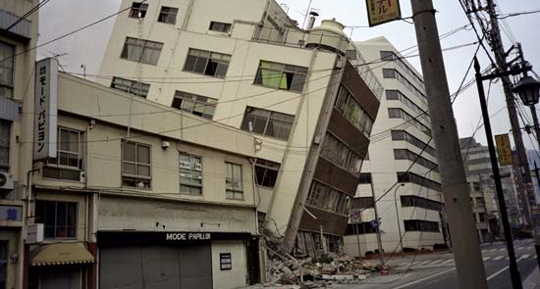
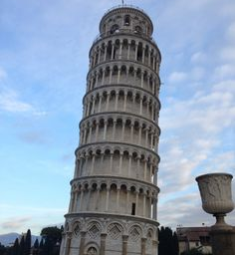
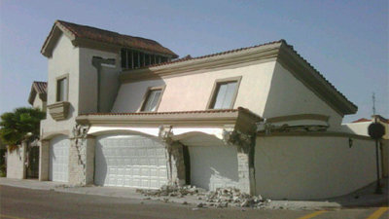
Notes:
Examples of “bad” foundations.

Slide 9
Overall Structure
Records
Records = Rows = Slot
Notes:
For the purpose of this presentation, I will be using “records”.

Slide 10
Overall Structure
Records
Records = Rows = Slot
Pages
Records live in Pages

Slide 11
Overall Structure
Records = Rows = Slot
Records live in Pages
Group of 8 Pages

Slide 12
Overall Structure

Slide 13
Everything is stored in a record, somewhere
Data
Forwarding
Index
Versioned Records
Ghost Records
Large Object (LOB)
And so on…
Notes:
For the purposes of this presentation we will talk about data records

Slide 14

Data Records
Records that actually store your data!
Data Records store two basic types of data
Fixed Length
Variable Length
Notes:
In order to talk about how things work, let’s review just a little!

Slide 15
Fixed Data Types
Storage requirements to hold the data is fixed
INTEGER -- 4 bytes
DATETIME – 8 bytes
CHAR(x) – X bytes
CHAR(5) = 5 bytes
NCHAR(x) – 2*X bytes
NCHAR(5) = 2*5 = 10 bytes
Notes:
Just as a refresher on the two types of data, fixed & variable.

Slide 16
Variable Data Types
Storage requirements varies on the size of the data
VARCHAR(x) – X bytes (up to 2GB via varchar(max))
VARCHAR(5) = 5 bytes (assuming a full column)
NVARCHAR(X) – 2*X bytes (up to 2GB via nvarchar(max))
NVARCHAR(5) = 2*5 = 10 bytes (assuming a full column)
Notes:
The size totals assume that the column is filled to the max.
Now that we have an understanding on the data types, let’s talk about how the data is physically stored.
Time to show what’s under the hood really…

Slide 17
2 bytes | 2 bytes | N bytes | 2 bytes | N/8 bytes | 2 bytes | 2 x (# of variable cols) bytes | N bytes
Variable Length
Data
Variable Column Offsets
NULL Values
Variable Column
Count
# of Columns
Fixed Length
Data
Variable Column
Offset Array
NULL Bitmap
NULL Bitmap
Offset
Tag Bytes
Notes:
Tag bytes = what type of record is it
NULL Bitmap offset = forward pointer to where the NULL bitmap lives
Fixed length data = stores the fixed length data
Null bitmap = A combination of the total number of columns (2 bytes) and a bit for every column to see if it’s NULL or not. N/8 = 8 bits = 1 byte
Variable column offset array = stores the end of each column so that the engine can easily determine the size of the column in conjunction of the number of variable columns
Variable length data = the actual data itself is stored here.
----- Meeting Notes (7/25/13 13:31) -----
What are the record types?
NULL Bitmap tracks which columns in the row have NULL values. There is a BIT for each column.
Null bitmpa offset points to the START of the NULL Bitmpa. It’s a pointer FORWARD in the record!! This tells us how big the fixed data length portion of the record is.

Slide 18
2 bytes | 2 bytes | N bytes | 2 bytes | N/8 bytes | 2 bytes | 2 x (# of variable cols) bytes | N bytes
Variable Length
Data
Variable Column Offsets
NULL Values
Variable Column
Count
# of Columns
Fixed Length
Data
Variable Column
Offset Array
NULL Bitmap
NULL Bitmap
Offset
Tag Bytes
Notes:
Tag bytes = what type of record is it
NULL Bitmap offset = forward pointer to where the NULL bitmap lives
Fixed length data = stores the fixed length data
Null bitmap = A combination of the total number of columns (2 bytes) and a bit for every column to see if it’s NULL or not. N/8 = 8 bits = 1 byte
Variable column offset array = stores the end of each column so that the engine can easily determine the size of the column in conjunction of the number of variable columns
Variable length data = the actual data itself is stored here.
----- Meeting Notes (7/25/13 13:31) -----
What are the record types?
NULL Bitmap tracks which columns in the row have NULL values. There is a BIT for each column.
Null bitmpa offset points to the START of the NULL Bitmpa. It’s a pointer FORWARD in the record!! This tells us how big the fixed data length portion of the record is.

Slide 19
Record Structure
2 bytes | 2 bytes | N bytes | 2 bytes | N/8 bytes | 2 bytes | 2 x (# of variable cols) bytes | N bytes
Tag Byte tells SQL Server metadata about the record. Always two bytes
Variable Length
Data
Variable Column Offsets
Variable Column
Count
NULL Values
# of Columns
Fixed Length
Data
NULL Bitmap
Offset
Tag Bytes
NULL Bitmap
Variable Column
Offset Array
Notes:
Tag bytes = what type of record is it
NULL Bitmap offset = forward pointer to where the NULL bitmap lives
Fixed length data = stores the fixed length data
Null bitmap = A combination of the total number of columns (2 bytes) and a bit for every column to see if it’s NULL or not. N/8 = 8 bits = 1 byte
Variable column offset array = stores the end of each column so that the engine can easily determine the size of the column in conjunction of the number of variable columns
Variable length data = the actual data itself is stored here.
----- Meeting Notes (7/25/13 13:31) -----
What are the record types?
NULL Bitmap tracks which columns in the row have NULL values. There is a BIT for each column.
Null bitmpa offset points to the START of the NULL Bitmpa. It’s a pointer FORWARD in the record!! This tells us how big the fixed data length portion of the record is.

Slide 20
Records
CREATE TABLE Sharknado(
CustomerID INT
, CustomerName VARCHAR(50)
, CustomerState CHAR(2)
);
How big can this row be?
Notes:
Now we know how the row is structured, let’s calculate the total size of a single row. The size calculate assumes that we are filling the varchar to the maximum.
TK – personal preference but I hate it when code isn’t colored and looks like code. Although, no bullet point on the code

Slide 21
Records
For the: | Bytes
Tag | ?
NULL Offset Bitmap | ?
Fixed Data Length | ?
# of columns | ?
Null Columns (N/8) | ?
Variable Column Count | ?
Variable Column Offset | ?
Variable Length Columns | ?
Total: | ? bytes
CREATE TABLE Sharknado(
CustomerID INT
, CustomerName VARCHAR(50)
, CustomerState CHAR(2)
);
Notes:
Now we have an understanding on how records are structured, let’s take a look at what holds the records for us! Pages!

Slide 22
Records
For the: | Bytes
Tag | 2
NULL Offset Bitmap | 2
Fixed Data Length | 6
# of columns | 2
Null Columns (N/8) | 1
Variable Column Count | 2
Variable Column Offset | 2
Variable Length Columns | 50
Total: | 67 bytes
CREATE TABLE Sharknado(
CustomerID INT
, CustomerName VARCHAR(50)
, CustomerState CHAR(2)
);
Notes:
Now we have an understanding on how records are structured, let’s take a look at what holds the records for us! Pages!

Slide 23
Overall Structure
Pages
Records live in Pages

Slide 24
Pages
All pages are 8192 bytes (8k) in size.

Slide 25
Pages
All pages are 8192 bytes (8k) in size.
Every page has a Header.
Header

Slide 26
Pages
All pages are 8192 bytes (8k) in size.
Every page has a Header.
Pages store the rows.
Header
Row 1
Row 3
Row 2

Slide 27
Pages
All pages are 8192 bytes (8k) in size.
Every page has a Header.
Pages store the rows.
Every page has a slot array.
Header
Row 1
Row 3
Row 2
Slot Array
Notes:
I know how you are making this flow and it makes sense. If you want to trim the last 4 slides down for time consolidation though, you could lead with just this one and kill the other 3. I see both sides though. You have impact by flowing the areas in at a time so that is only a time and deck consolidation method. Making this automated would save you time too

Slide 28
Pages
96 Bytes for Header
Header
Row 1
Row 3
Row 2

Slide 29
Pages
96 Bytes for Header
Header
Row 1
Row 3
8096 Bytes for Rows
Row 2

Slide 30
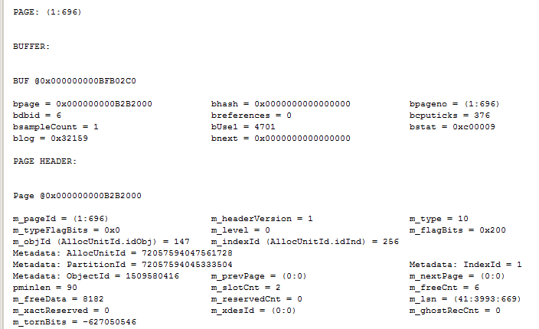
Pages - Header
Things to Note:
Page Type
Object ID
Ghost Count Record
Slot Count
Notes:
Looks at the header of the page

Slide 31
Pages - Header

Slide 32
Pages - Header
Notes:
1 - Data page
2 - Index page
3/4 - Text pages
8 - GAM page
9 - SGAM page
10 - IAM page
11 - PFS page

Slide 33
Pages
Single page size limit for data is 8060 bytes
No exceptions
Can store single record or multiple records
Off row storage
Slot Array
Stores the offsets to each row on the page
2 bytes per row
The rows do not have to be stored in order physically on the page
The slot array offsets will stored in sorted order
Notes:
Mention off-row storage. Yup, you’re right, you CAN store more than 8060 per row, but SQL Server has to shove the contents of the columns to row-overflow data IF the total combine length of all of the columns is greater than 8060 bytes. Only variable length data will be stored off row. The off-row storage requires an additional 24 byte record.

Slide 34
Pages
Header
Row 1
Not in order!!
Row 3
Row 2

Slide 35
Pages
Records are stored on the same type of pages
IE: Data records are stored on Data pages
IE: Index records are stored on Index pages
Boot page
Page (1:9) (file:page#)
Store metadata about the database
Very critical page.
If corrupt, restore is the only option
Notes:
Paul Randal recently showed a method of copying the page header for the boot page from another backup copy.

Slide 36
Overall Structure
Extents
Group of 8 Pages

Slide 37
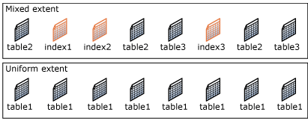
Extents
Groups of 8 contiguous pages
Easier page allocation for SQL Server
Mixed Extents
Single pages that are allocated to different objects
Dedicated Extents
8 pages that are allocated to the same object
http://technet.microsoft.com/en-us/library/ms190969(v=sql.105).aspx
Notes:
Trace Flag 1118

Slide 38
Tools
What tools do can we use?
DBCC IND
DBCC PAGE
Sys.fn_PhysLocFormatter
Sys.dm_db_database_page_allocations
Notes:
Show the code here

Slide 39
Tools
What tools do can we use?
DBCC IND
DBCC PAGE
Sys.fn_PhysLocFormatter
Sys.dm_db_database_page_allocations
Undocumented
Sort of
Unsupported
Sort of
Notes:
Show the code here

Slide 40
Tools
What tools do can we use?
DBCC IND
DBCC PAGE
Sys.fn_PhysLocFormatter
Sys.dm_db_database_page_allocations
Not Supported by Microsoft. There are a TON of folks online willing to help with issues and/or questions.
Undocumented
Sort of
Unsupported
Sort of
Notes:
Show the code here

Slide 41
DBCC IND
DBCC IND(
<DatabaseName>
,<‘tablename’>
, <Index_ID>
);
For example:
DBCC IND(AdventureWorks,’Person.Person’,1)
Notes:
TK - Now, run this again but a different one than the demo you just did when you first mentioned DBCC IND - Make sure you use the right wording for AdventureWorks. AdventureWorks2012 and so on.

Slide 42
DBCC PAGE
DBCC PAGE(
<database_name>
, <fileid>
, <pagenumber>
, <detail_level>
);
For example:
DBCC PAGE(AdventureWorks, 1, 696, 3)
Notes:
TK – again, run it and watch that AW name

Slide 43
DBCC PAGE
DBCC PAGE(
<database_name>
, <fileid>
, <pagenumber>
, <detail_level>
);
For example:
DBCC PAGE(AdventureWorks, 1, 696, 3)
0 = Header
1 = Header/hex dump for rows
2 = Header/page dump
3 = Header/detail row info
Notes:
TK – again, run it and watch that AW name

Slide 44
DBCC PAGE
DBCC PAGE(
<database_name>
, <fileid>
, <pagenumber>
, <detail_level>
);
For example:
DBCC PAGE(AdventureWorks, 1, 696, 3)
Note: Must execute DBCC TRACEON(3604) BEFORE DBCC PAGE!
Notes:
TK – again, run it and watch that AW name

Slide 45
SYS.DM_DB_DATABASE_PAGE_ALLOCATIONS
SELECT * FROM
SYS.DM_DB_DATABASE_PAGE_ALLOCATIONS(
<database_id>
, <table_id>
, <index_id>
, <partition_id>
, <mode>)
For example:
sELECT * FROM SYS.DM_DB_DATABASE_PAGE_ALLOCATIONS(db_id(),object_id(‘dbo.table1’),NULL,NULL,’DETAILED’)
Notes:
DEMO

Slide 46


Slide 47

JUST KIDDING!
Notes:
DEMO time!!

Slide 48
How many will fit on a page?
CREATE TABLE Sharknado(
CustomerID INT
, CustomerName VARCHAR(50)
, CustomerState CHAR(2)
);
For the: | Bytes
Tag | 2
NULL Offset Bitmap | 2
Fixed Data Length | 4+2 = 6
# of columns | 2
Null Columns (N/8) | 1
Variable Column Count | 2
Variable Column Offset | 2
Variable Length Columns | 50
Total: | 67 bytes
Notes:
Now we have an understanding on how records are structured, let’s take a look at what holds the records for us! Pages!

Slide 49
How many will fit on a page?
CREATE TABLE Sharknado(
CustomerID INT
, CustomerName VARCHAR(50)
, CustomerState CHAR(2)
);
8060 / 69 bytes = 116 rows per page
Notes:
8060/67 = 120 rows per page.

Slide 50
Bring it all together
Row Density
How much data do we have in the row?
Are we pushing to off-row storage because of bad design?
Page Density
How many rows do we have on the page?
Notes:
Now that we understand how data is stored, if we plan our structures accordingly, we’ll save space on the row, thus saving space on the page and helping SQL Server find the data faster!!

Slide 51

Summary
Understanding the internals is critical for everything.
Smart table design will lead to:
More rows on a page
Less Pages to store the data
Less Work for SQL Server to read the pages
Faster response times
My Happy User!
HAPPY USERS!!!
Notes:
If you have good understanding of internals, you’ll build better databases, if you build better databases, your sql server will respond better. If your sql server responds better you’ll have happy users.

Slide 52
Resources
MCM Readiness Video
http://technet.microsoft.com/en-US/sqlserver/gg313756.aspx
DBCC IND/PAGE
Paul Randal - http://www.sqlskills.com/blogs/paul/category/dbcc/
http://blogs.msdn.com/b/sqlserverstorageengine/archive/2006/12/13/more-undocumented-fun_3a00_-dbcc-ind_2c00_-dbcc-page_2c00_-and-off_2d00_row-columns.aspx
Data Types
http://msdn.microsoft.com/en-us/library/ms187752.aspx
SGAM, GAM, IAM, PFS, DIFFMAP
http://blogs.msdn.com/b/sqlserverstorageengine/archive/2006/07/08/under-the-covers-gam-sgam-and-pfs-pages.aspx
Anatomy of a Record (Paul Randal)
http://www.sqlskills.com/blogs/paul/inside-the-storage-engine-anatomy-of-a-record/

Slide 53
THANK YOU!!!!
john@dcac.co
http://linkedin.com/in/sqlrus
@SqlRUs
http://www.sqlrus.com

